Slide 1
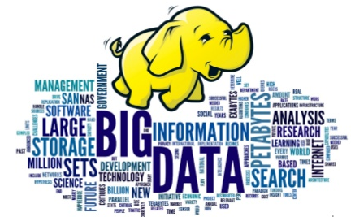
Big Data & Hadoop
Kamal Kant
S170026

Slide 2
BIG DATA
Extremely large data sets that may be analyzed computationally to reveal patterns, trends, and associations, especially relating to human behavior and interactions.
Data that is too big to be processed by a single machine.
How Big :
Facebook hosts more than 240 billion photos , growing at 7 PB per months
The New York Stock Exchange generates 4-5 PB per day
Traditional data processing application software is inadequate to deal with such large data.

Slide 3
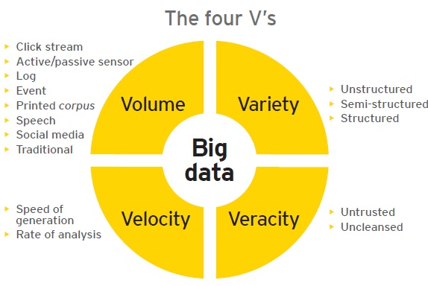
Characteristics

Slide 4
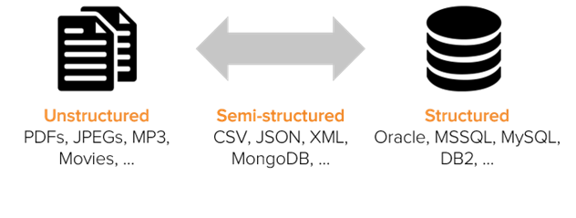
Types of Data

Slide 5
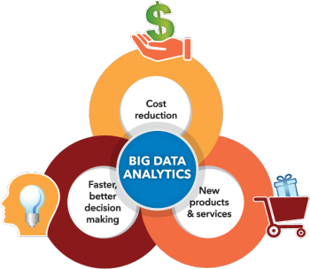
Importance Of Big Data
Cost reductions and Time reduction
New product development and optimized offerings
Smart decision making (faster and better decision making).
Determining root causes of failures, issues and defects in near-real time.
Generating coupons at the point of sale, based on the customer’s buying habits.
Detecting fraudulent behaviour before it affects the organization.

Slide 6

Dealing with BigData
Apache Hadoop
Microsoft HDInsight
Big data in EXCEL
PolyBase
Presto
SkyTree

Slide 7

Apache Hadoop
Apache Hadoop is an open-source software framework used for distributed storage and processing of dataset of big data.
Uses the MapReduce programming model.
It consists of computer clusters built from commodity hardware.

Slide 8
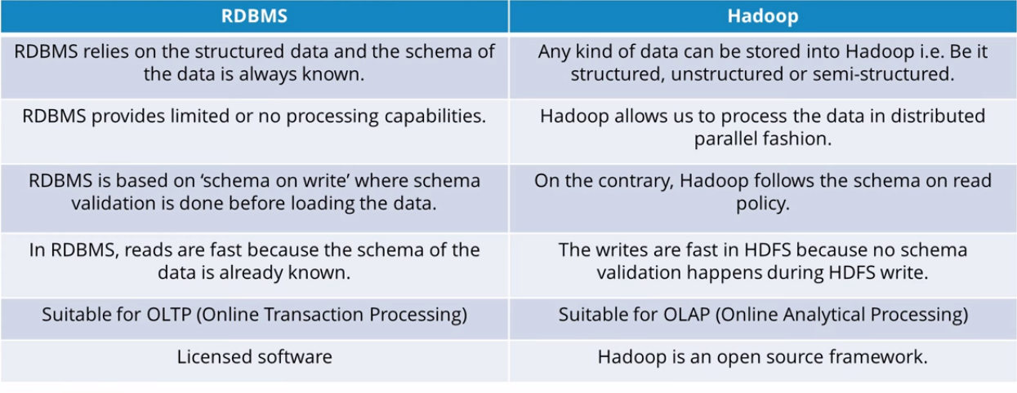
Hadoop vs RDBMS

Slide 9
Benefits of Hadoop
Scalability
Scale out : Adding more nodes to a cluster
Scale up: Adding more CPU/ram/external hardware to the existing nodes
Reliability – In case of node failure processing is re-directed to the remaining nodes in the cluster and data is automatically re-replicated in preparation for future node failures.
Flexibility – Don’t have to create schemas on write, Schemas created on read
Low cost - Hadoop is open source and runs on low-cost commodity hardware

Slide 10
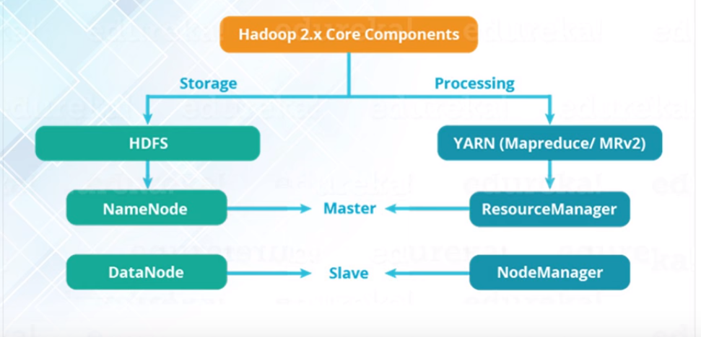
Hadoop Components

Slide 11
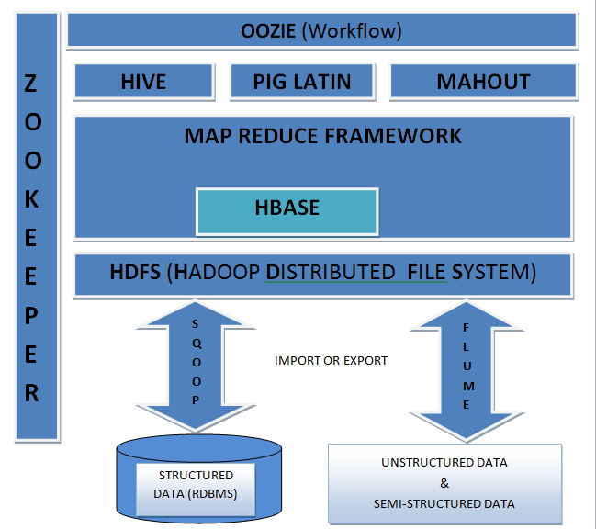
Hadoop Ecosystem

Slide 12
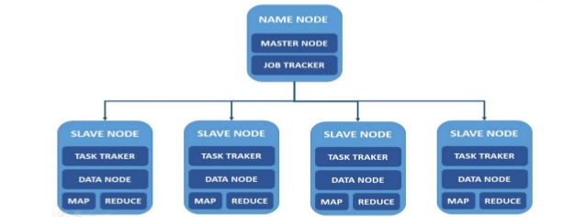
Hadoop Master/Slave Architecture

Slide 13

Hadoop HDFS

Slide 14

Features of HDFS
Distributed Storage – Data is stored in distributed manner
Blocks – Data is split into blocks
Replication – Blocks are replicated at different nodes
High Availability – Data is highly available due to replication
Data Reliability – Data is stored reliably in HDFS
Fault tolerant – Data replication provides fault tolerance feature
Scalability – Nodes in HDFS cluster can be increased on the fly
High throughput access to application – Parallel processing provides high throughput access to application

Slide 15
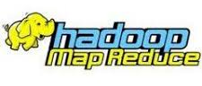
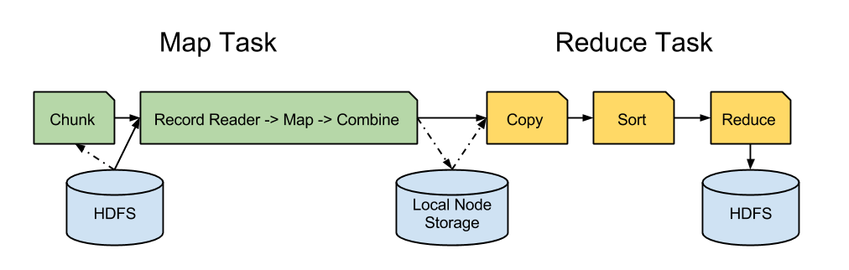
MapReduce framework
This framework includes
User defined <key,value>
User also defines Map Reduce function
Hadoop handles the logistics
Parallel processing is provided
Divides the input into map and reduce task
Communicating intermediate results to Reducers

Slide 16
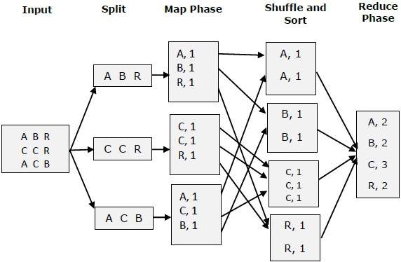
MapReduce Illustration

Slide 17
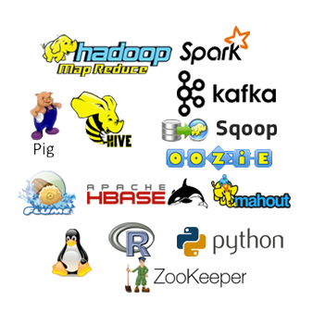
Hadoop Tools
HIVE
Pig
Sqoop
Hbase
Oozie
Flume
ZooKeeper
Mouth
Avro
Spark
Imphala
MongoDB

Slide 18

Hive
Hive is SQL based Data warehouse system for data summarization, ad-hoc query, and analysis of large datasets
uses a SQL-like language called HiveQL (HQL).
Hive is not a relational database, but a query engine that supports the parts of SQL specific to querying data
By default hive uses derby database to store metastore.
The location of metastore is metastore_db

Slide 19

Apache Pig
Pig consists of high level scripting/procedural language PigLatin
Used for Extract –Transform-Load(ETL) data sets
Pig enables to solve queries fast without knowing Java
Execution modes
Local mode – read and write data using local system
MapReduce mode – read and write data using HDFS

Slide 20
Pig vs hive
Pig
Procedural Data Flow Language
For Programming
Pig is SQL like but varies to a great extent.
Hive enables developers not familiar with MapReduce to write data queries that are translated into MapReduce jobs in Hadoop.
Hive
Declarative SQLish Language
For creating reports
Directly leverages SQL and is easy to learn for database experts.
Its compiler translates Pig Latin into sequences of MapReduce programs

Slide 21

Sqoop
Sqoop acts like a intermediate layer between Hadoop and relational database systems. You can import data and export data between relational database systems and Hadoop and its eco-systems directly using sqoop.
Sqoop works with relational databases such as Teradata, Netezza, Oracle, MySQL, Postgres, and HSQLDB
Uses JDBC to connect with relational databases

Slide 22

Flume
Data need to process generating from data sources like applications servers, social networking sites, cloud servers, and enterprise servers. This data will be in the form of log files and events.
Apache Flume is a distributed, reliable, and available service for efficiently collecting, aggregating, and moving large amounts of streaming data/logdata into the Hadoop Distributed File System (HDFS).

Slide 23

Hbase
Hadoop Database or HBASE is a non-relational (NoSQL) database that runs on top of HDFS.
HBASE was created for large table which have billions of rows and millions of columns with fault tolerance capability and horizontal scalability and based on Google Big Table.

Slide 24

OOZIE
Apache Oozie is a Java Web application used to schedule Apache Hadoop jobs.
Oozie combines multiple jobs sequentially into one logical unit of work.

Slide 25

ZooKeeper
ZooKeeper is a centralized service for maintaining configuration information, naming, providing distributed synchronization, and providing group services.
ZooKeeper's architecture supports high availability through redundant services
ZooKeeper nodes store their data in a hierarchical name space, much like a file system or a tree data structure

Slide 26

Description of project (H1B – Case Study)
The H1B is an employment-based, non-immigrant visa category for temporary foreign workers in the United States.
For a foreign national to apply for H1B visa, an US employer must offer a job and petition for H1B visa with the US immigration department.
We will be performing analysis on the H1B visa applicants between the years 2011-2016
The dataset has nearly 3 million of records.
The data is in .csv format and off 492MB.
The dataset is unstructured form.

Slide 27


Implementation
Total analysis to be performed were 11
Pre-processing of data (cleansing) is done through Hive
MapReduce (4)
Pig (3)
Hive (3)
Sqoop (1)
Menu is build on shell-scripting

Slide 28

CONCLUSIONS
Total number of application increases over year.

Slide 29

CONCLUSIONS
Certified visa increases over year and denied percentage decreases.

Slide 30

CONCLUSIONS
Statistians (SOC_name) has the most number of Data Scientist positions.
Though MapReduce code written in Java makes the complex analysis quite easy, Hive and Pig are easier to retrieve data efficiently and lines of code is also very less compared to MapReduce programs.
The no of petitions filed for data engineering jobtitle is increasing over time but the max Percentage Increase is in 2014 from previous year(2013).

Slide 31
Thank you

